Slide 1
Zation Unit 1860s-1900s Where: Northeast, Midwest and Westcoast Cities
Industrialization-discoveries and inventions that improved manufacturing, transportation and the everyday lives of Americans
Immigration-People began moving to the United States for employment opportunities and the chance for the American Dream
Urbanization-the growth of cities upward and outward. Cities beginning to take a modern look (skyscrapers, mass transit, street lights).

Slide 2
Railroads
Railroad Use
Helped Farmers get crops to market
Helped Cowboys sell cattle to butchers
Helped ship goods and people from coast to coast.

Slide 5
Railroads Stimulate The Economy
Carried raw materials to factories.
Carried manufactured goods from factories to markets
Steel tracks could carry bigger loads farther, faster
R.R. created jobs in the steel, lumber, and coal industry

Slide 6
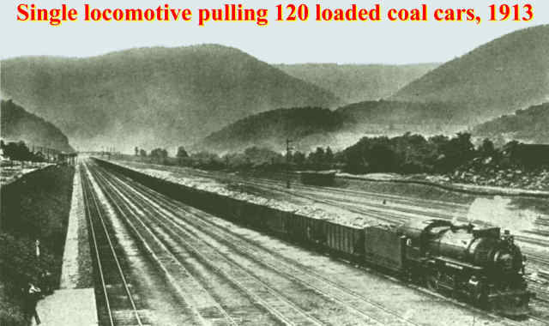
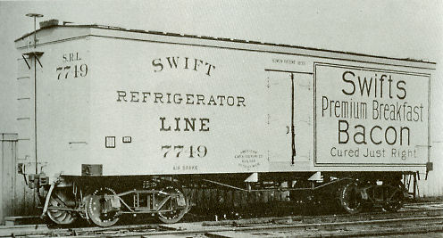
Making It Rich off the Railroad
Many made a fortune in the Railroad industry
Refrigerated Cars
Couplers Connected R.R. Cars

Slide 7
Railroad Barons & Railroad Invention Tycoons
Cornelius Vanderbuilt
Bought several railroad companies and railroad tracks
George Westinghouse
Invented the air break, allowing trains to stop much faster
Eli Janney
Invented the coupler, allowing trains cars to connect to one another

Slide 8
Railroad Barons & Railroad Invention Tycoons Continued
Gustavus Swift
Created the refrigerated car, allowing food to be shipped coast to coast.
George Pullman
Created the passenger car. Helps create tourism industry.
Food For thought
These business owners grew in wealth, at the expense of their workers.
There were few laws regulating big business.

Slide 9
Pullman Cars: George Pullman created the first passenger cars

Slide 10
Vanderbilt Mansion

Slide 11
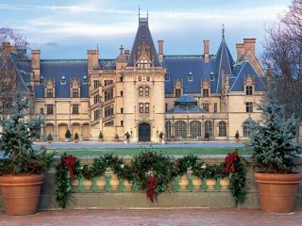
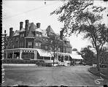
How wealthy are we talking kids? We’re talking extreme, beyond belief wealth
http://www.nyc-architecture.com/NP/NP.htm
Vanderbilt Home
Pullman House

Slide 12
Inventions Change the way Americans Lived on a daily basis.
Invention | Inventor | Impact on Daily Life during the late 1800s | Modern equivalent
Light Bulb
Electric Plants
Typewriter
Telephone
Shoe maker
Vacuum Cleaner
Camera
Adding Machine
Model T
Chain Stores

Slide 13
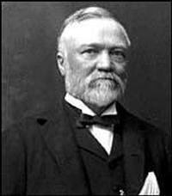
Andrew Carnegie
Scottish immigrant from impoverished family
Hard working teen raised enough money to invest in steel industry
Used Vertical Integration to become a millionaire
1900 making $25 Mil a year

Slide 14
John D. Rockefeller-Oil Barron
Became a successful business man at 19
In 1870 founded Standard Oil
Used horizontal integration to build a monopoly
“Rule or Ruin”-led to his owning 95% of oil refineries in the country
Made $340 billion in today’s money

Slide 15
New inventions and the R.R. helped Big Business Boom during this time
John D. Rockefeller obtained great wealth in the oil industry
Andrew Carnegie did the same in the steel industry.
How did JP Morgan make his millions?

Slide 16
Define the following in your notes.
Corporation
Laissez Faire
Social Darwinism
Vertical Integration
Horizontal Integration
Trusts
Monopoly
Pool
Holding Company
Sherman Anti-Trust Act

Slide 17
Big Business
Term | Definition | Example

