Slide 1
Era of “good feeling” presentations

Slide 2
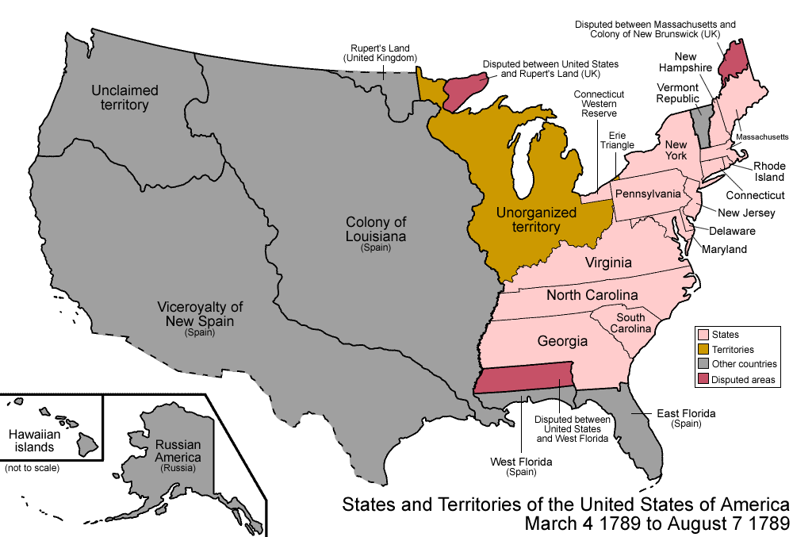
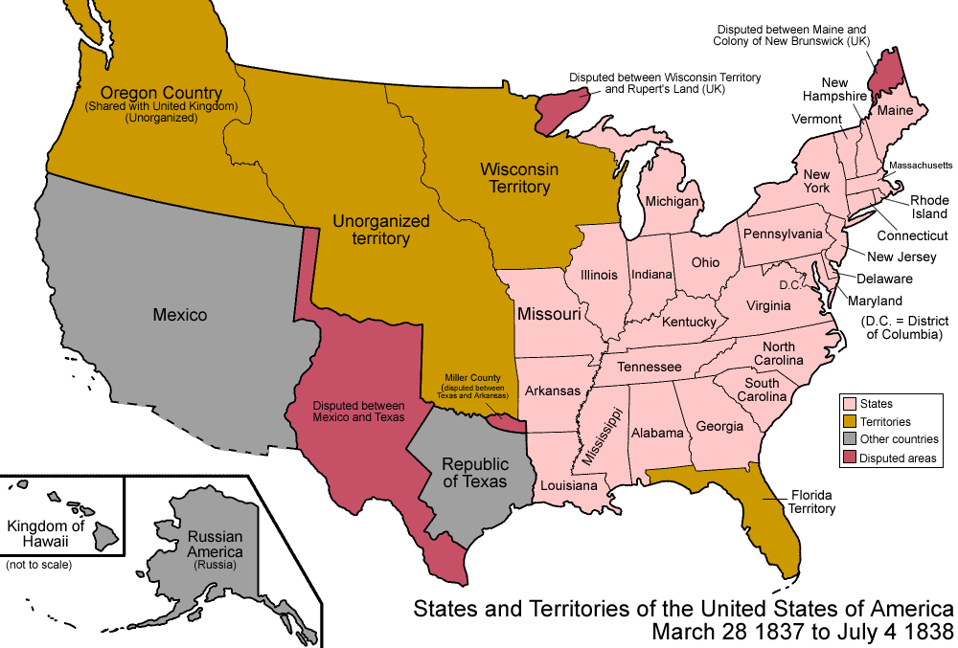
Growing pains in the west
This was new land for the Americans that was really cheap
People in the west were powerless
Expansion west allowed a better navigation of the country

Slide 3
slavery AND THE SECTIONAL BALANCE
Missouri tied to enter as slave state
Angered by attempt to emancipate slave children with Tallmadge amendment
Other states thought that congress may try to do something like that to them

Slide 4
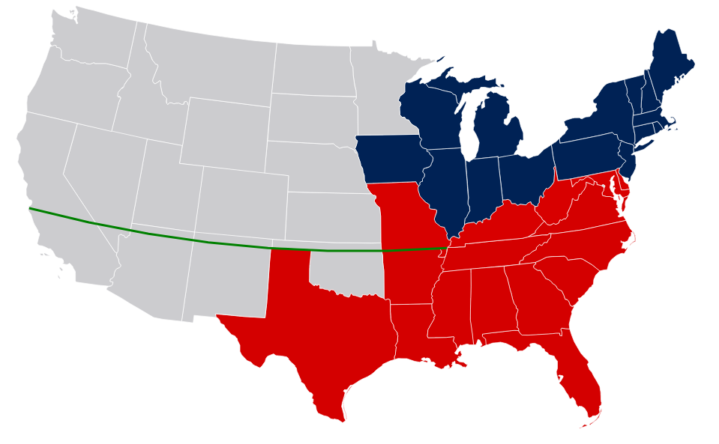
THE UNEASY MO. COMPRIMISE
Missouri is admitted as a slave state while Maine is admitted as a free state
The Compromise lasted 34 years and preserved the shaky compact of the states
Slaves were prohibited in all states above the 36 30 line

Slide 5
John Marshall and judicial nationalism
John Marshall declared the national bank constitutional
He put power with federal government at the expense of the states
People were angry that he was taking power away from the states

Slide 6
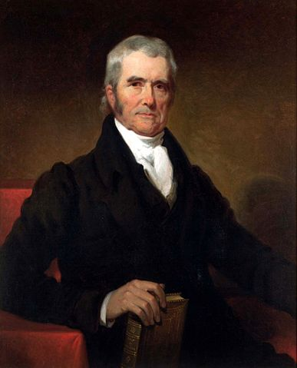
Judicial dikes against democratic excesses
Judicial barriers against democratic attacks of state government
Right of Supreme Court to invalidate state laws conflicting with the federal Constitution
John Marshall’s decisions still felt today, nationalism, shaped the Constitution

Slide 7
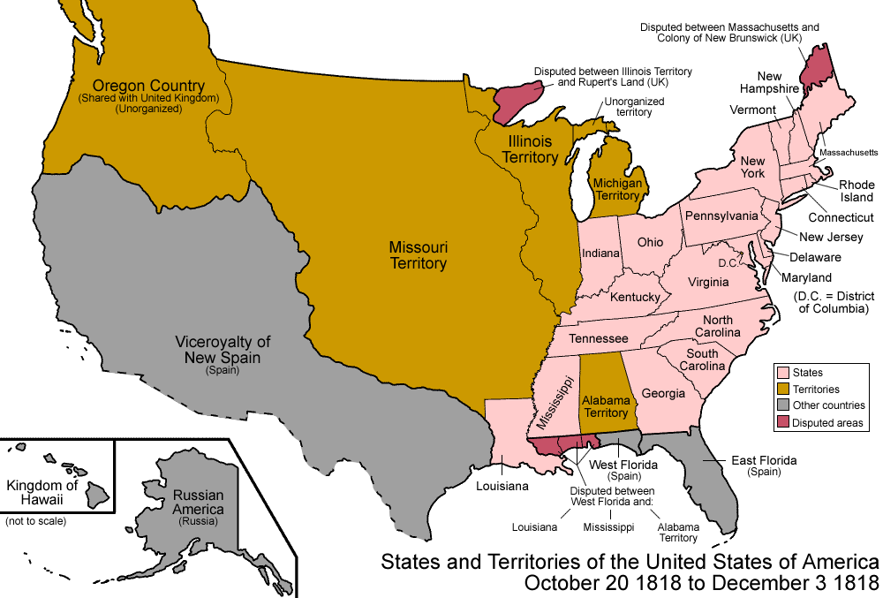
Sharing Oregon and acquiring Florida
Treaty of 1818 permitted ten-year joint occupation of untamed Oregon Country without surrender of rights or claims of either Britain or America (This didn’t work out; America claimed Oregon for itself eventually)
Early in 1818 Jackson swept across the Florida border and caused massive destruction
Jackson captured Pensacola and St. Mark’s, the two most important posts in the area

Slide 8
The menace of monarchy in america
Spanish were getting stronger
Britain wants to team up, to get western America
Americans wanted western land

Slide 9
Monroe and his doctrine
President Monroe’s annual letter to congress (1823) contained the Monroe Doctrine. The Monroe Doctrine discouraged Europeans of colonization and ‘puppeteer monarchy’ in the United States.
Invoked in 1865 when the U.S. government exerted diplomatic and military pressure in support of the Mexican President Benito Juárez. Enabled Juárez to lead a revolt against the Emperor Maximilian, placed on the throne by the French government.
Increased isolationism and brought new controversial foreign policies. Flushed out some of the Mexicans and Canadians.

Slide 10
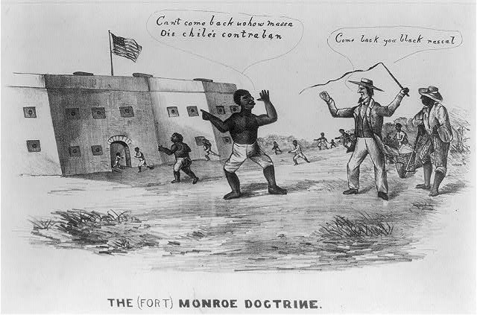
Monroe’s doctrine appraised
Monroe’s Declaration was of the gulf between America’s pretentious pronouncements and it’s puny military strength
The Republic was insulted from European dangers because they wanted it to be a nationalistic outburst; Monroe warned the Old World powers to stay away
Monroe's Doctrine should have been called the Self- Defense Doctrine

