Slide 1
New Deal
Label and describe 2 programs from the New Deal that correctly fit into each of the following categories. Look at pages 777-781 and 790-791 in your in-class book.

Slide 2
Family
1)
2)

Slide 3
Farms
2)

Slide 4
Banks
2)

Slide 5
Business
2)

Slide 6
Watch this Video to help better Understand the Summary of the New Deal
https://www.youtube.com/watch?v=WvcWeNf9g6A

Slide 7
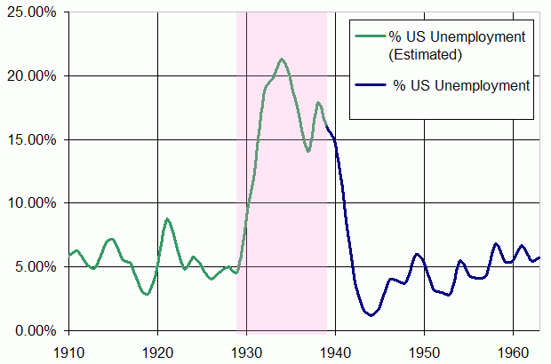
Look at each primary source and briefly explain how the New Deal was helping Americans during the depression.

Slide 8
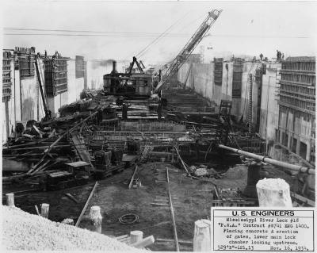

Slide 9
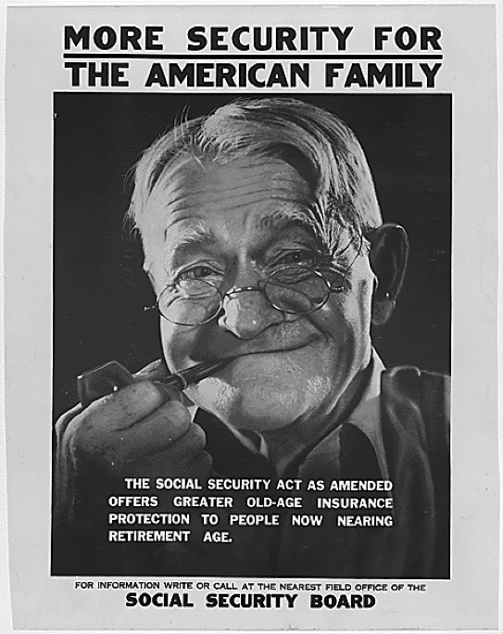

Slide 10
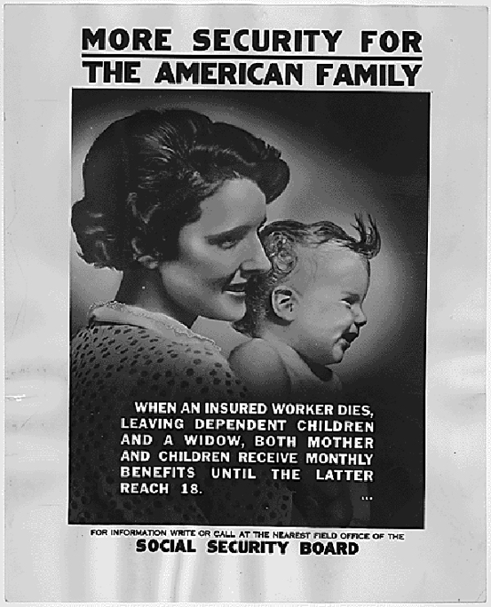

Slide 11
Roosevelt Is a “Damned Good Man”
I was born in the old country—Italy—41 years ago and came over here when I was 3 months old. Things have certainly changed a lot in forty years….
I can get a job today even if we got a depression. I don't mean that I wasn’t on relief when things got tough because there was a time when everything was shut down and I had to get on relief for a job. It isn’t so long ago I was working on WPA. Believe me it was a big help. But it wasn’t the kind of a job I should have had because this town is Republican and I am a Republican and I was a good worker for the party—making voters and helping a lot of people out—getting their taxes rebated (abated). Getting jobs for them. When it came my turn that I needed help the politicians told me that I had to go on relief—well, when I did I was handed a shovel and pick….Roosevelt is a damn good man—you take all these young fellows and you can't talk to them like in the old days to swing them over. Today all these kids are satisfied on WPA and the NYA. My son works there and gets 44 cents an hour….
You know sometimes I wonder what way we are drifting—some of the laws that was passed in the last few years were very good for the people and I guess you know what happened. You take the N.R.A. I think that was very good—it gave everybody a chance except those who are misers and are never satisfied if they make 100 dollars a week. This other law the Social Security I believe is the best. The only fault I find is that a man has to reach the age of 65 before he can collect. Well how many do? [?] They tell you nowadays that a person lives longer— well they used to before this depression but[,?] hell[,?] today you worry your god damn head off on how to meet both ends and that makes your life much shorter. You see what I mean that this government wants to do something good for the people and does but damn it they put strings to it.
Tell me how many reach the age of 65? Very few. Why the hell don't they give a person a break and say at 56 years old you should retire from work and enjoy life instead of waiting until he is almost dead they give him a few dollars a month. I think the whole shooting match is wrong. And unless we get the crooks and chislers out of Washington we'll remain the same.
Library of Congress, Manuscript Division, WPA Federal Writers' Project Collection. Public domain, http://www.loc.gov/teachers/classroommaterials/presentationsandactivities/presentations/timeline/depwwii/newdeal/goodman.html.

Slide 12
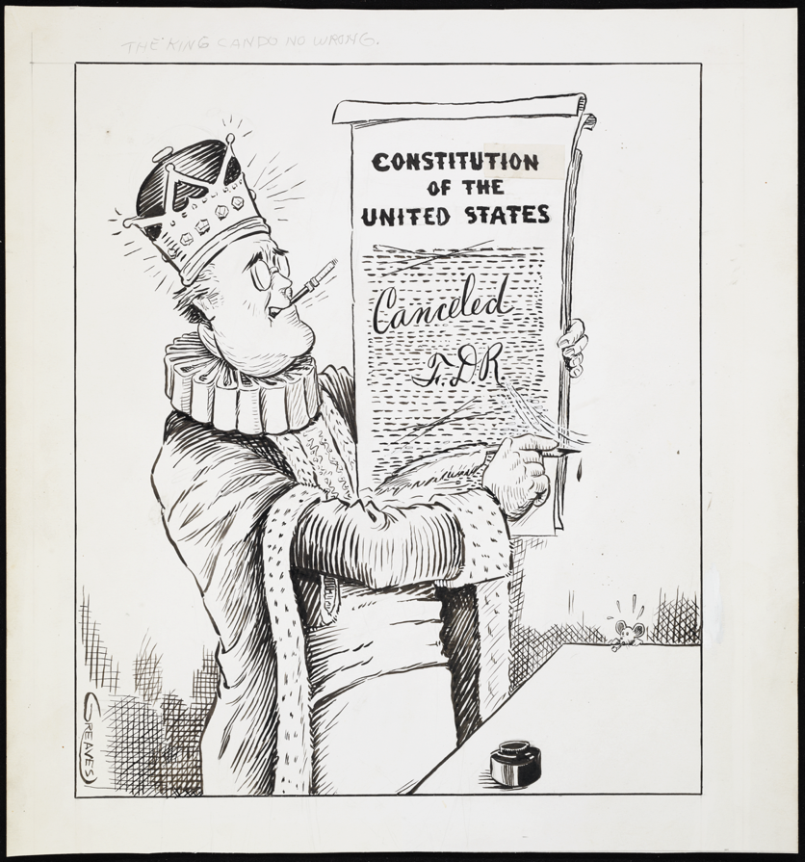
Look at each primary source and briefly explain how the New Deal was a negative Impact on the United States.

Slide 13
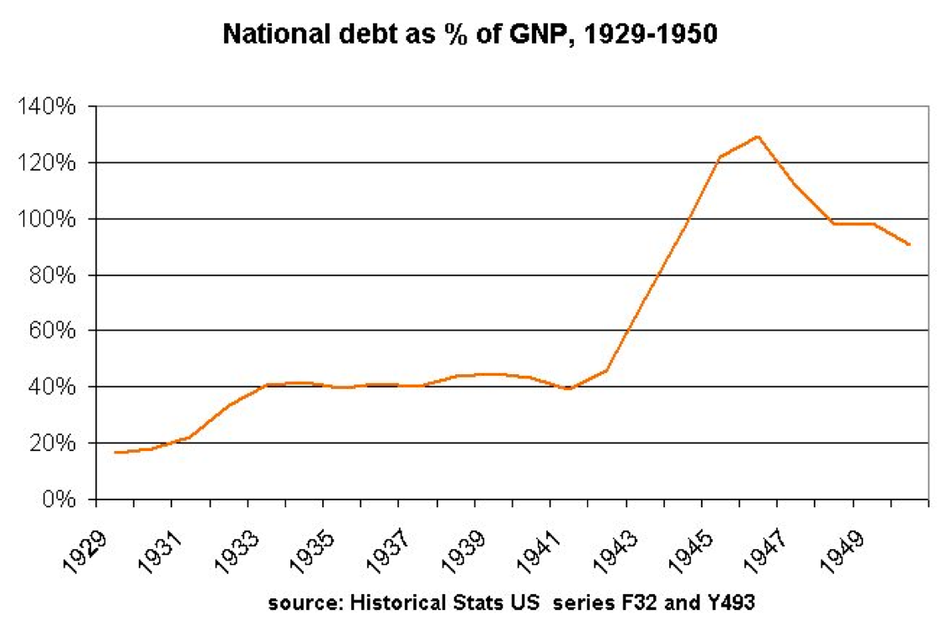

Slide 14
I wish to state also that I will not vote again for any candidate for President of the United States, who belongs to the Democratic or Republican party, as I believe that anyone of these presidents has not an ideology really democratic and just, for those of us who work, and produce, and are respectful of the law.
Library of Congress, Manuscript Division, WPA Federal Writers' Project Collection. Public domain, http://www.loc.gov/teachers/classroommaterials/presentationsandactivities/presentations/timeline/depwwii/newdeal/failure.html
The New Deal Was a Failure
As to the New Deal, I believe that it has been a failure as it has protected the trusts more than the American people. Today, the poor are poorer, and the trusts are richer. Another reason: this is a county that is controlled by the trusts. When one stands on the street, and closes his eyes for a moment, and then opens them and looks; everything, absolutely all that one sees is made by the trusts. The automobile that passes by, the street car, the trucks, everything that one wears: shoes, clothes, etc. When one enters a restaurant, he sees the plates, the tables, the spoons, all is made by the trusts. 95% of what one eats is controlled by the trusts. The trusts for more than 200 years have been controlling all the industries, and killing the small business men. We have reached a state in which the trusts dominate all, as they are the owners of the money, or nearly all the money that there is in the United States….
I do not believe that Roosevelt will solve this crisis, for if he had wanted to, as he promised to the American people, he would have solved it, as the Legislature and the Senate have given Roosevelt more power than any other president of the United States….
I must state in making these declarations that I was one of so many fools that believing in the so much “cackled” New Deal, and that I went to deposit my vote for the one who is today President of the United States, Franklin D. Roosevelt, who has deceived my most pure illusions with the respect to the solution of this great crisis….
l

Slide 15
Was the New Deal a Good Deal? Are we a better country today or worse because of FDR’s New Deal? Please provide at least 2 specific details to support your explanation.

