Slide 1
Terms
Sensation
Perception
Absolute Threshold
Difference Threshold
Signal Detection Theory
Sensory Adaptation

Slide 2
Sensation Experiments

Slide 3

Difference Threshold

Slide 4

Absolute Threshold

Slide 5
Signal Detection Theory

Slide 6
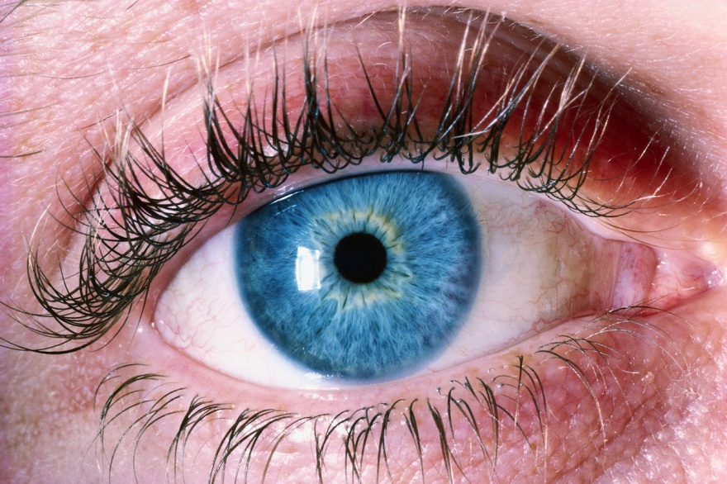
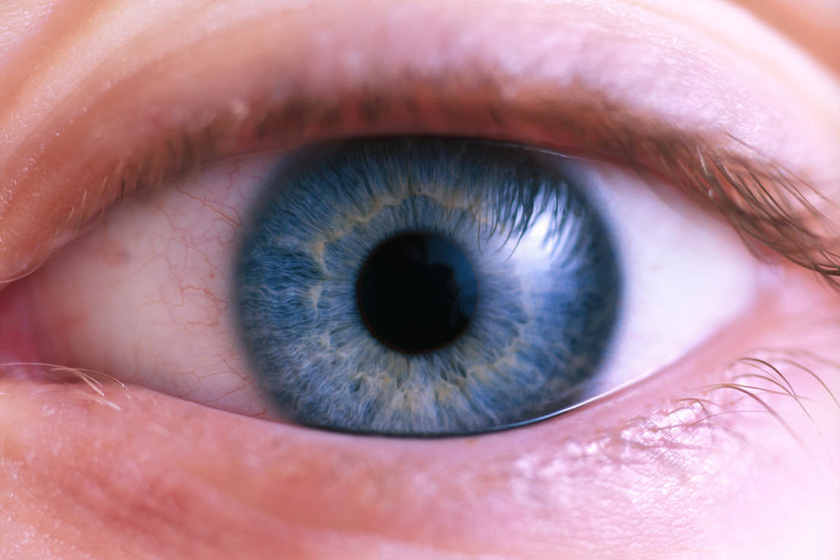
Sensory Adaptation

Slide 7
More on Vision

Slide 8
Which woman is more attractive?

Slide 9
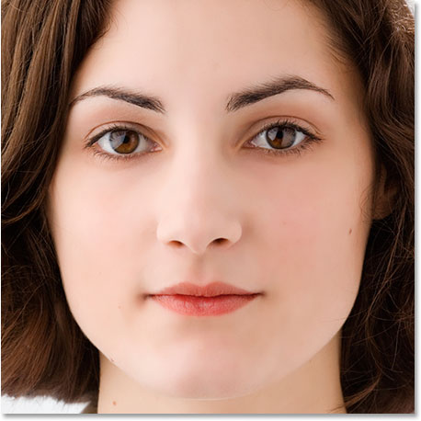

Slide 10
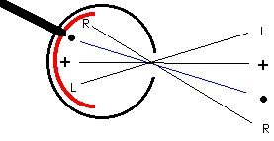
Blind Spot

Slide 11
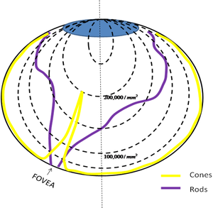

Rods
&
Cones

Slide 12
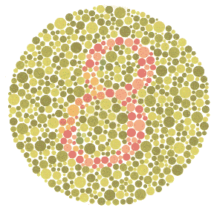
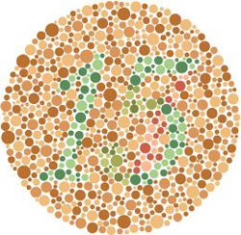
Color Blindness

Slide 13

Afterimages

Slide 14

After images

Slide 15
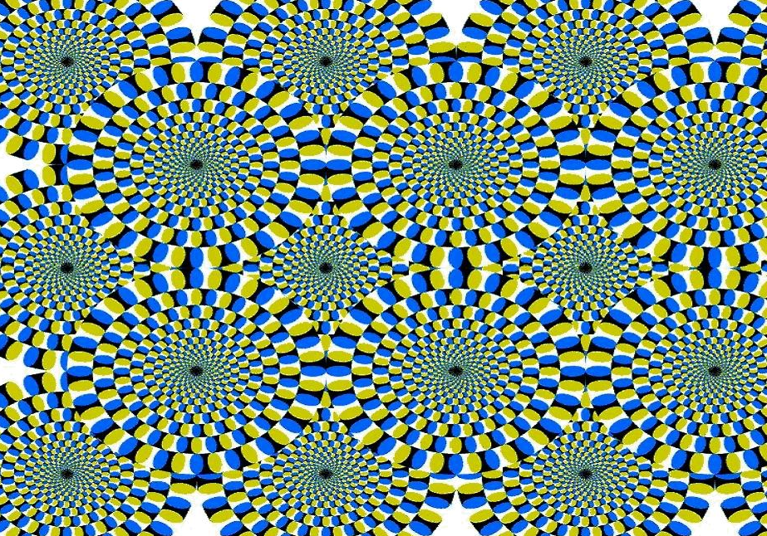
a little taste of “perception”

Slide 16
Senses

Slide 17
In Each Sense Group
Part of the brain used for this sense
How the sense functions
How this sense affects behavior

Slide 18
13 Rules of Perception
--Closure --Stroboscopic Motion
--Figure-Ground --Depth Perception
--Proximity --Size Constancy
--Similarity --Color Constancy
--Continuity --Brightness Constancy
--Common Fate --Shape Constancy
--Perception of Movement

Slide 19
Perception Demos

Slide 20
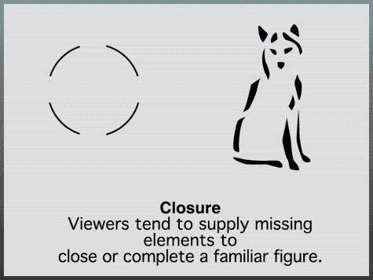
Closure

Slide 21

Figure-Ground

Slide 22
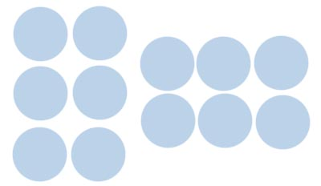
Proximity

Slide 23
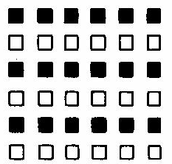
Similarity

Slide 24
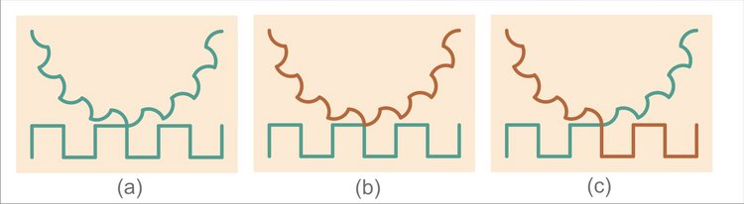
Continuity

Slide 25

Common Fate

Slide 26


Perception of Movement

Slide 27
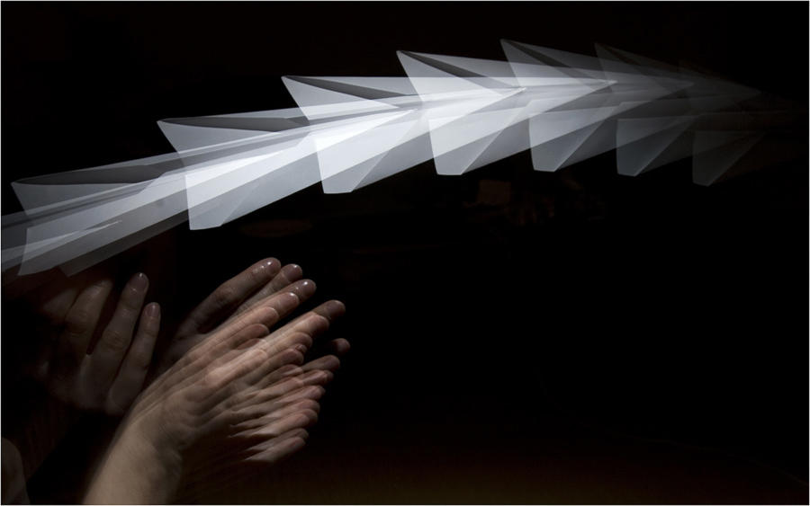
Stroboscopic Motion

Slide 28
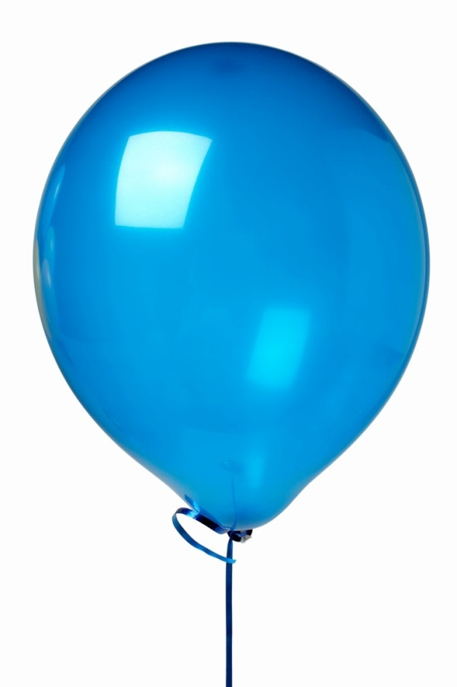
Depth Perception
Monocular Cues

Slide 29

Depth - Binocular

Slide 30
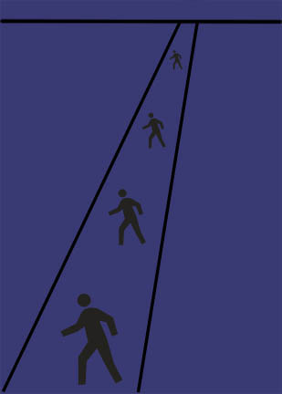
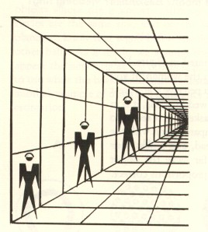
Size Constancy

Slide 31
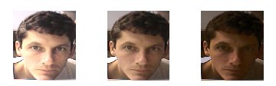
Color Constancy

Slide 32

Brightness Constancy

Slide 33

Shape Constancy

Slide 34


Slide 35
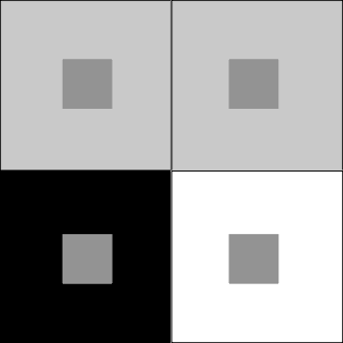

Slide 36


Slide 37
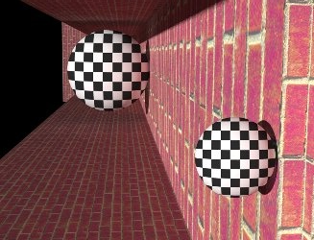

Slide 38
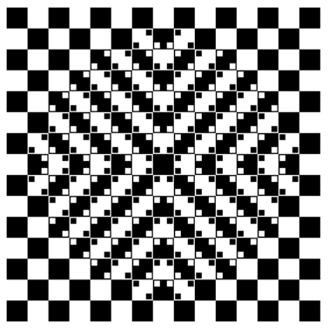

Slide 39


Slide 40


Slide 41
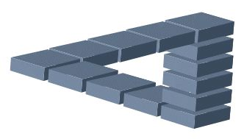

Slide 42
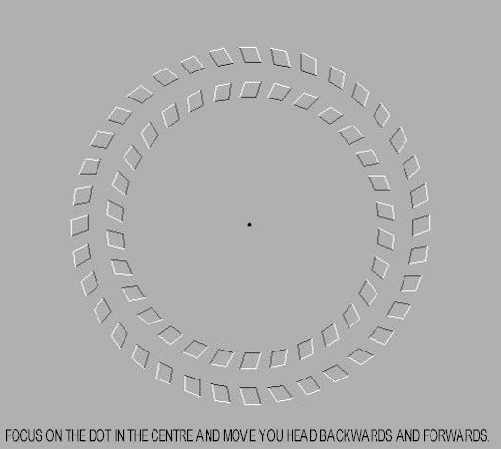

Slide 43
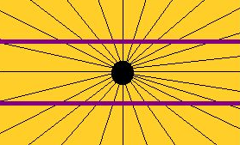

Slide 44


Slide 45
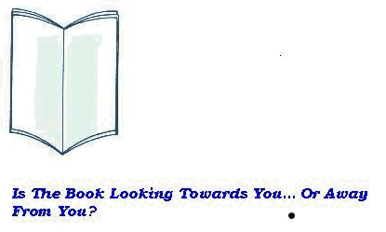

Slide 46
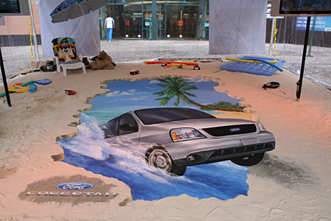

Slide 47


Slide 48


Slide 49
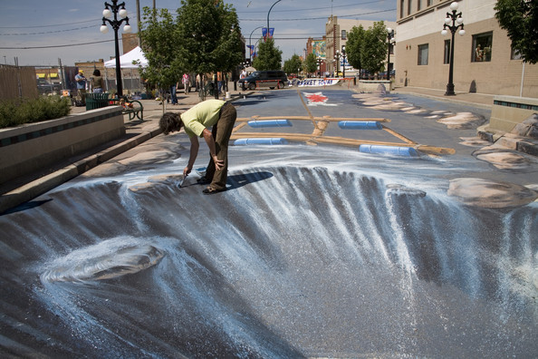

Slide 50
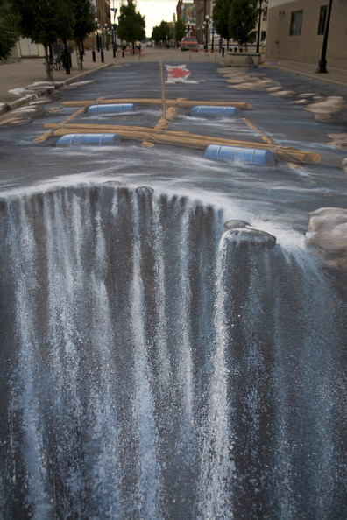

Slide 51


Slide 52
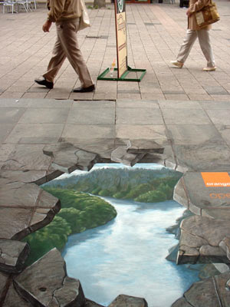

Slide 53
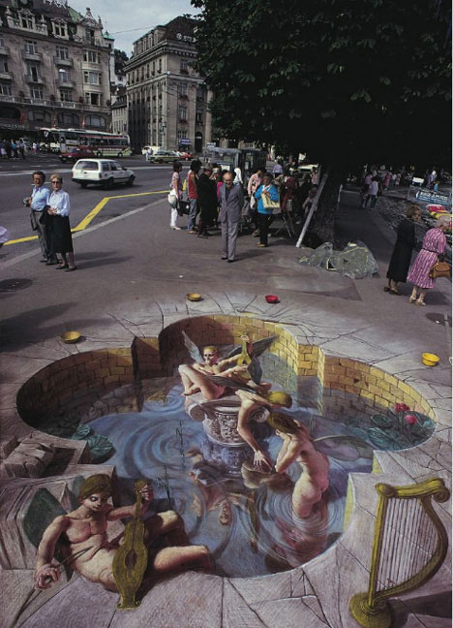

Slide 54
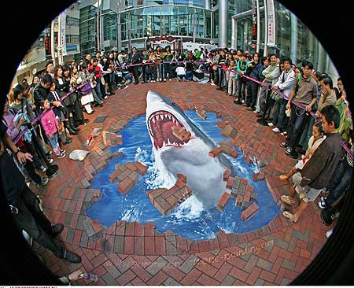

Slide 55
