Slide 1
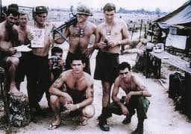
The Vietnam Conflict
1964-73

Slide 2
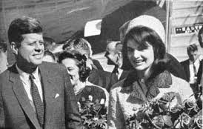
Prior to 1964
We don’t like Japan in WWII (give money and weapons to Ho Chi Minh)
France takes over area, French Indochina becomes a colony of FR
French Indochina fights off the French, takes about 10 years
North supports communism (under Minh) and the US supports a corrupt Diem Regime
JFK will send advisors only, 1964

Slide 3
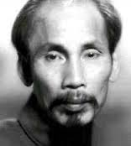
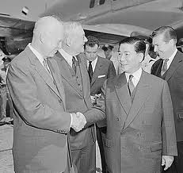
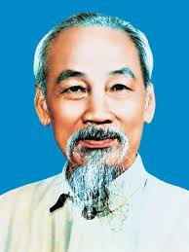
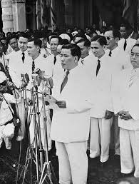
Leader Comparison
US fears communist Minh
US supports Diem (democratic)
Diem cancels elections
Has popular support of his people, communism most appealing to the small poor country

Slide 4
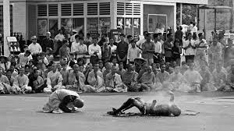
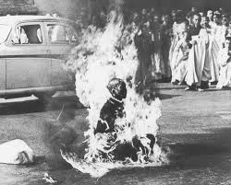

Slide 5
1964-1968
Gulf of Tonkin incident, Maddox fired upon
North Vietnam invades South Vietnam
Escalation

Slide 6
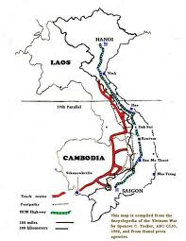
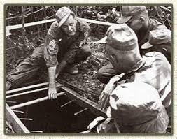
US issues
Fighting along Ho Chi Minh Trial
US not allowed in through Cambodia
Guerilla Warfare challenges
US will bomb Cambodia

Slide 7
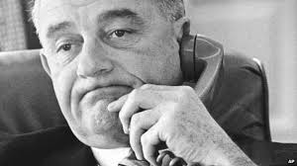
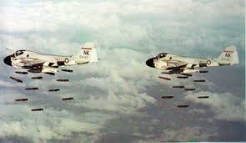
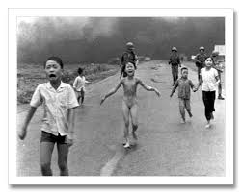
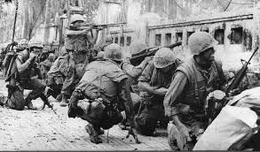
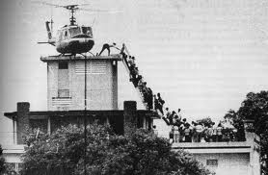
1968-72
Tet Offensive in ‘68
Anti-War Movement
Johnson does not seek re-election in ‘68
War goes public, Mai Lai Massacre
Nixon will try to create the ‘Vietnamization” of the war, and US goes to bombing campaigns
US out in ‘73, South fight on until ‘75

Slide 8
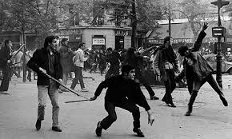
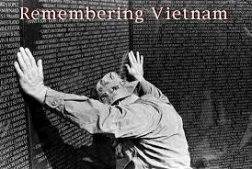
Legacy
Why do we really want to get involved in conflict? Questioning the Government
Vietnam goes Communist

