Slide 1
Native American Culture, 1860-90
Mode of survival/family life/dwellings/view of land ownership

Slide 2
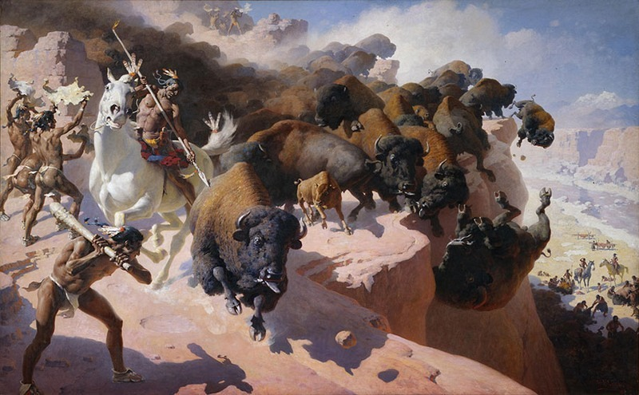
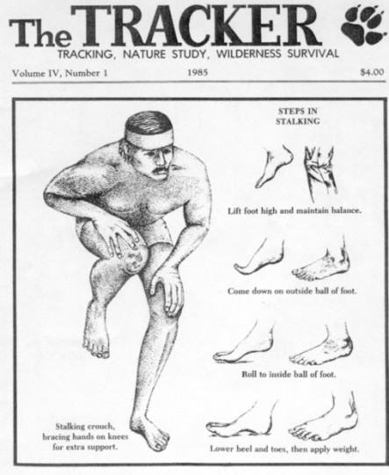
Mode of Survival
Communal Living
Buffalo is paramount to survival
Nomadic across the plains
“Foxwalk”…how they hunt small game

Slide 3
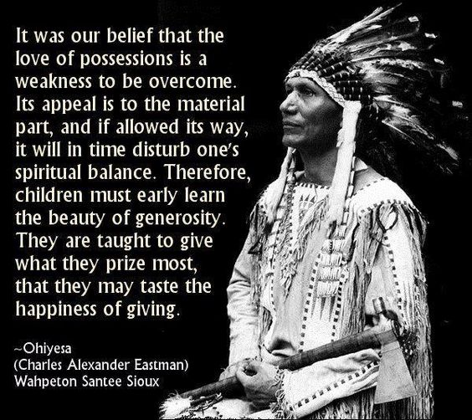
Family Life
Whole tribe is a family “it takes a village to raise a kid”
Chiefs have control, Elders have great respect, Medicine Man is also influential member of society
Communal/Community

Slide 4
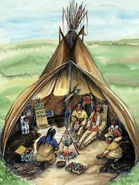
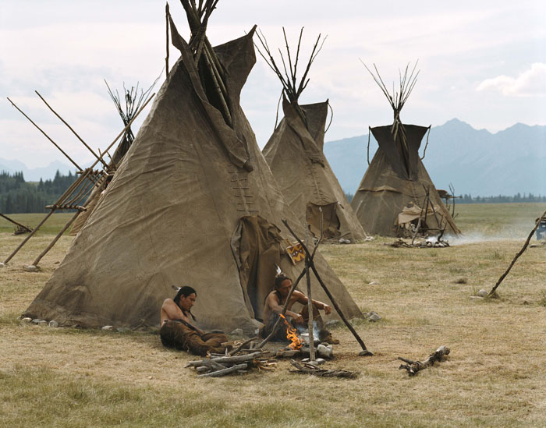
Dwellings
Wigwam/Tipi on PLAINS: TEMPORARY DWELLINGS, PORTABLE
Longhouse in NE, more permanent
Adobe Houses in SW (dirt brick, like soddies): more permanent

Slide 5
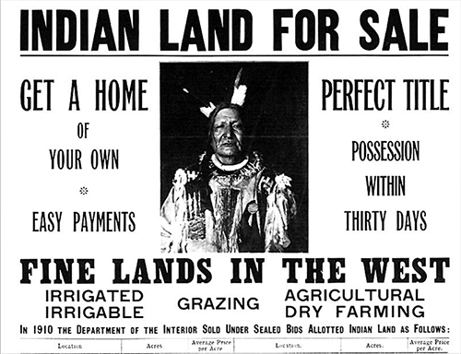
View of Land Ownership
You could NOT own land, you only USE the land
Cause CONFLICT btwn settlers and NA’s

