Slide 1
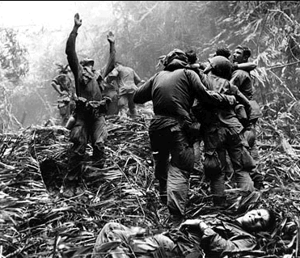
The Vietnam War

Slide 2
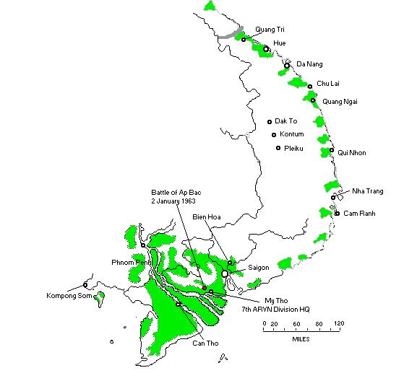
What was it?
The Vietnam War was a war that had Communist North Vietnam and its southern allies, the Viet Cong, fighting against South Vietnam and the United States.
The war ended in 1973 because of the withdrawal of United States help.
Vietnam united under Communist control two years later.
More than 3 million people, including 58,000 Americans, were killed throughout the war.

Slide 3
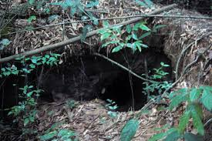
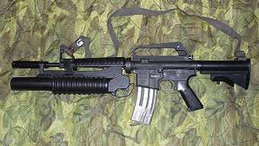
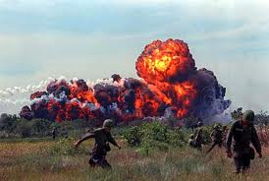
Vietnam Weapons
The weapons used in the Vietnam War were more devastating than those of any previous conflict.
The U.S. and South Vietnam relied on their superior air power (e.g. B-52 bombers).
Communist forces used weapons manufactured in the Soviet Union and China.
The U.S. used highly toxic chemical defoliants and herbicides.
The North Vietnamese-Viet Cong side used inventive booby traps using sharpened bamboo sticks or crossbows triggered by tripwires.
The U.S.-made M-16 rifle became the weapon most commonly associated with U.S. troops in the conflict.
Napalm was used in U.S. and South Vietnamese bombing runs and when mixed with gasoline and included in incendiary bombs or flamethrowers, napalm released large amounts of carbon monoxide when it exploded, poisoning the air.

Slide 4
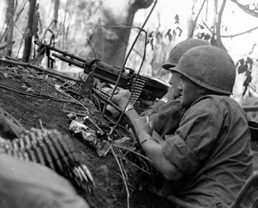
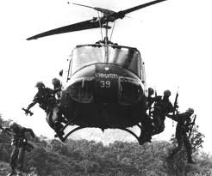
The Battle of Ap Bac
Occurred on January 2, 1962.
It was the first major battle of the Vietnam War.
It was fought by the Army of the Republic of Vietnam (ARVN) and the People’s Army of Vietnam (PAVN) at Ap Bac, a village in the Dinh Tuong province.
The battle resulted in heavy casualties for the South Vietnamese troops who had American assistance in weapons and planning.
This battle revealed the poor performances in both fighting ability and spirit of the South Vietnamese compared to the Viet Cong.

Slide 5
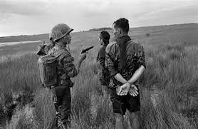
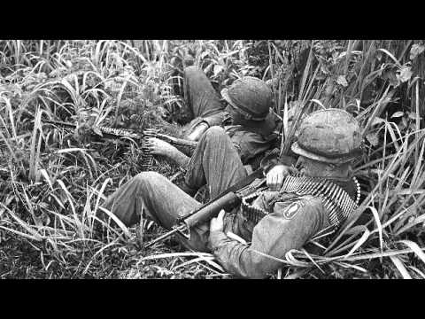
The Battle of Ia Drang Valley
Fought from October 26, 1965 to November 27, 1965.
It was the first major battle between the U.S. and the PAVN.
The battle occurred at the Landing Zone X-Ray and Albany in La Drang Valley, Central Highlands of South Vietnam.
Despite heavy casualties on both sides, both claimed the battle was a victory of their own.

Slide 6
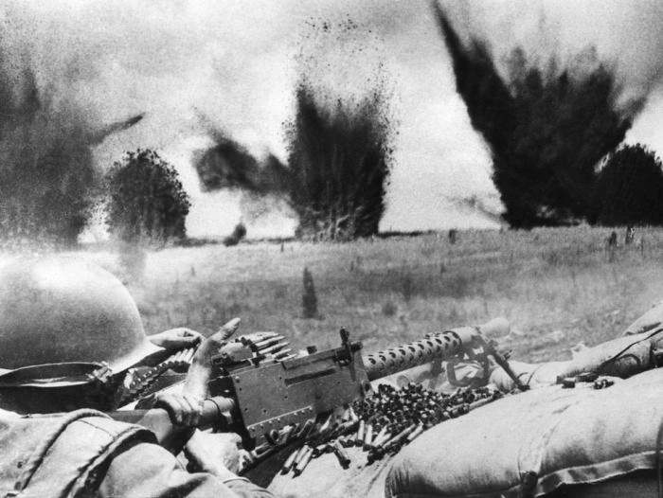
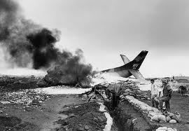
Battle of Khe Sanh
January 21 – April 9, 1968
Quang Tri province, North-western South Vietnam.
It began when PAVN troops began a heavy artillery attatck on the U.S. Marine garrison at Khe Sanh.
For 77 days, the Army of the Republic of Vietnam and U.S. Marines fought until Operation Pegasus ended the battle.
It was one of the longest and bloodiest battles of the Vietnam War.
Both sides claimed victory despite the fact that the U.S. had to abandon a combat base because of enemy pressure for the first time and the heavy casualties on the communists.

Slide 7
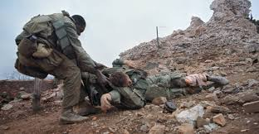
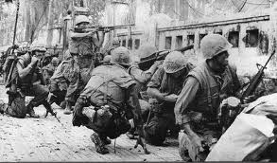
The Tet Offensive
January 31, 1968
70,000 North Vietnamese and Viet Cong forces.
It was a coordinated series of attacks on over 100 cities and towns in South Vietnam.
News coverage of the offensive shocked and dismayed the American public and eroded support for the war.
North Vietnam achieved a strategic victory with the Tet Offensive.

