Slide 1
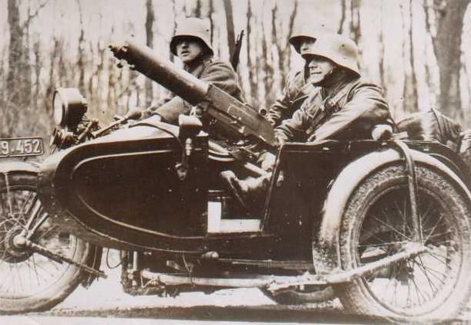
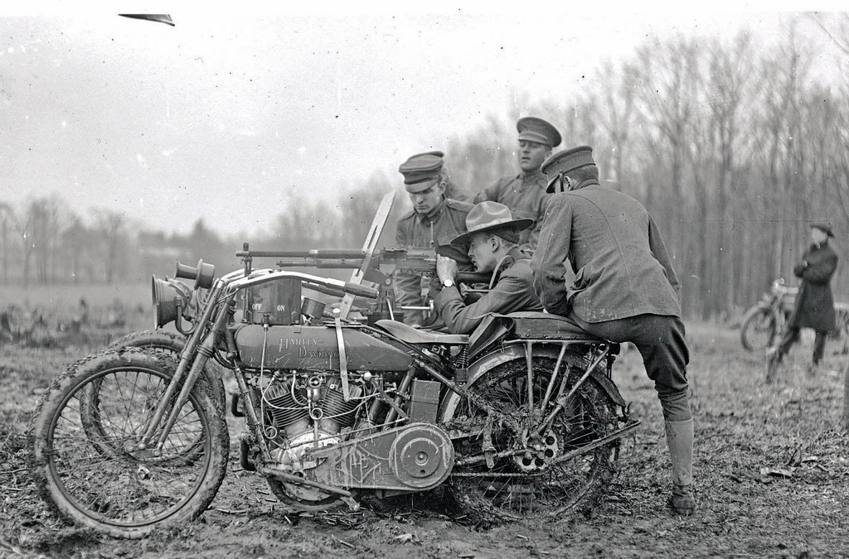
WWI Museum Quest
What year was Franz Ferdinand assassinated?
2. What country declared war on what country to begin WWI?
3. Which battle stopped the Schlieffen Plan in it’s tracks?
4. Japan attacked who’s forces that were helping China?
5. What helped the Allies defeat the Germans in Ypres?
6. When was Xmas observed by both sides on the western front (France)?
7. When was the Lusitania bombed?
8. Which country killed a nurse? Why?
9. Why did the Germans stop their submarine warfare?
10. How did President Wilson get re-elected?
11. What was the Zimmerman note? Why did the US get mad at it?
12. Along with the Lusitania, what boat was attacked inducing US deaths?
13. What is total war?
14. What happened to some women’s rights groups during WWI?
15. What were the basis of Wilson’s 14 Points?
16. When was the Armistice Signed?
17. When was the Treaty of Versailles and what did it accomplish?

